Slide 1
Meep and MPB for waveguide simulations

Slide 2
In this video
What is a waveguide?
Waveguide modes
Very informal
Eigenmode solvers + demonstration with MPB
Waveguide modes in FDTD
Eigenmode sources
Eigenmode monitors
Demonstration of waveguide simulations in Meep
Straight waveguide
Waveguide bends

Slide 3
Optical Waveguide
A wire for light

Slide 4
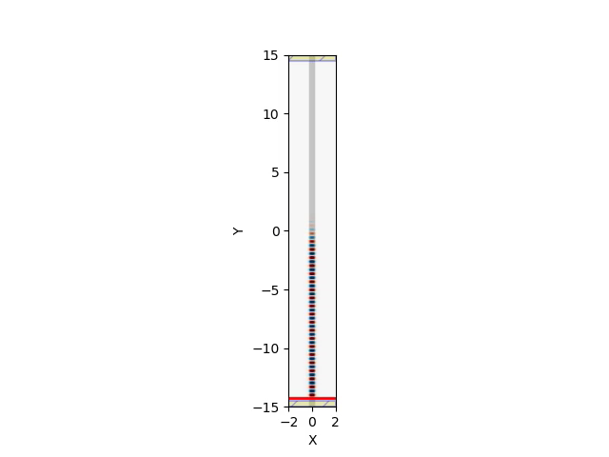
Optical Waveguide
A wire for light
Allows electromagnetic waves to travel in a confined space over long distances

Slide 5
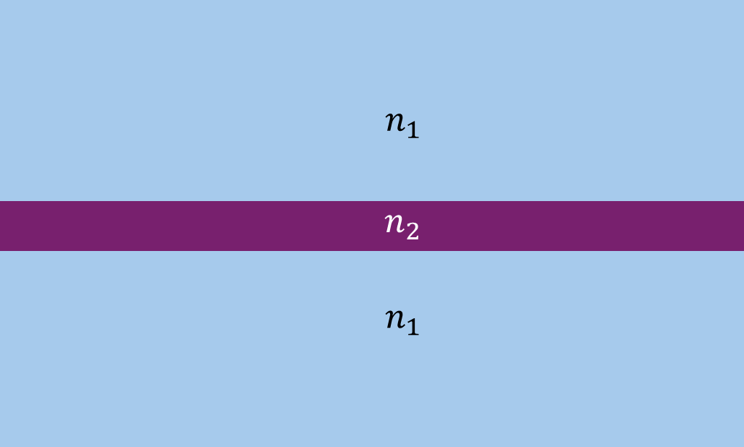

Optical Waveguide
A wire for light
Based on total internal reflection
cladding
core
$$n_{2}>n_{1}$$
cladding

Slide 6





Optical Waveguide
A wire for light
Based on total internal reflection
$$n_{2}>n_{1}$$
$$⇒$$
$$θ$$
$$R=1$$
$$θ≥θ_{c}$$

Slide 7

Optical Waveguide
A wire for light
Based on total internal reflection
$$n_{2}>n_{1}$$
$$⇒$$
$$θ$$
$$R=1$$
$$θ≥θ_{c}$$
Lossless propagation

Slide 8
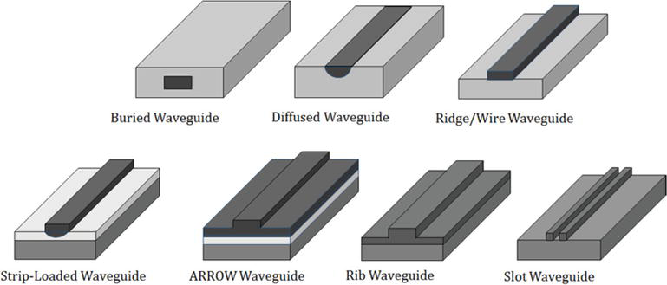
Optical Waveguide
A wire for light
Based on total internal reflection
Many different cross-sectional shapes, sizes, and materials
Uniform along the propagation direction
Propagation direction
https://www.intechopen.com/chapters/61838

Slide 9
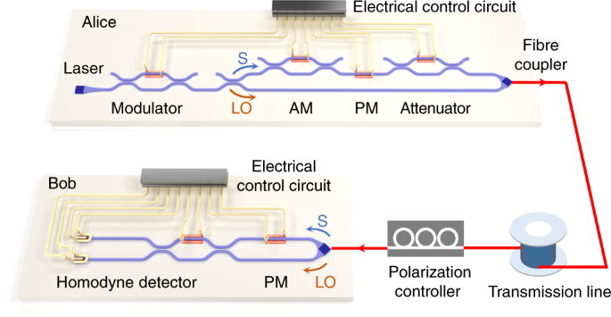
Optical Waveguide
A wire for light
Based on total internal reflection
Many different cross-sectional shapes, sizes, and materials
Allows for photonic integrated circuits
Zhang, G., Haw, J.Y., Cai, H. et al. An integrated silicon photonic chip platform for continuous-variable quantum key distribution. Nat. Photonics 13, 839–842 (2019). https://doi.org/10.1038/s41566-019-0504-5

Slide 10
Optical Waveguide
A wire for light
Based on total internal reflection
Many different cross-sectional shapes, sizes, and materials
Allows for photonic integrated circuits
Optical communications
Photonic computing
Quantum optics
etc.
Zhang, G., Haw, J.Y., Cai, H. et al. An integrated silicon photonic chip platform for continuous-variable quantum key distribution. Nat. Photonics 13, 839–842 (2019). https://doi.org/10.1038/s41566-019-0504-5

Slide 11
Electric Field in Waveguide
Waveguide is uniform along the propagation direction (y)

Slide 12
Electric Field in Waveguide
Waveguide is uniform along the propagation direction ($y$)
$$E\left(y\right)=e^{−iky}$$

Slide 13
Electric Field in Waveguide
Waveguide is uniform along the propagation direction ($y$)
$$E\left(x,y\right)=E\left(x\right)e^{−ik_{e}y}$$

Slide 14


Electric Field in Waveguide
$$k_{e}=\frac{2π}{λ_{e}}$$
$$E\left(x,y\right)=E\left(x\right)e^{−ik_{e}y}$$
Effective wavenumber
Effective wavelength

Slide 15

Electric Field in Waveguide
$$k_{e}=\frac{2π}{λ_{e}}$$
$$λ_{e}=\frac{λ_{0}}{n_{eff}}$$
$$E\left(x,y\right)=E\left(x\right)e^{−ik_{e}y}$$
Effective wavenumber
Vacuum wavelength
Effective wavelength
Effective refractive index

Slide 16
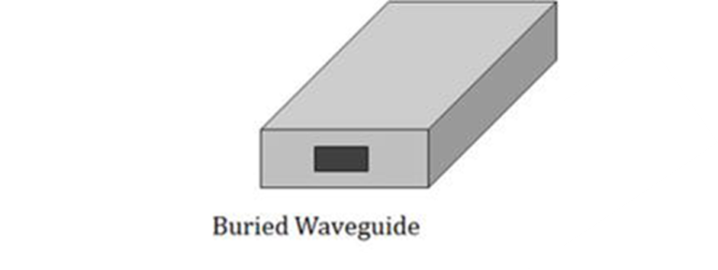



Electric Field in Waveguide
more generally …
$$E\left(x,y,z\right)=E\left(x,z\right)e^{−ik_{e}y}$$
$$z$$
$$y$$
$$x$$

Slide 17
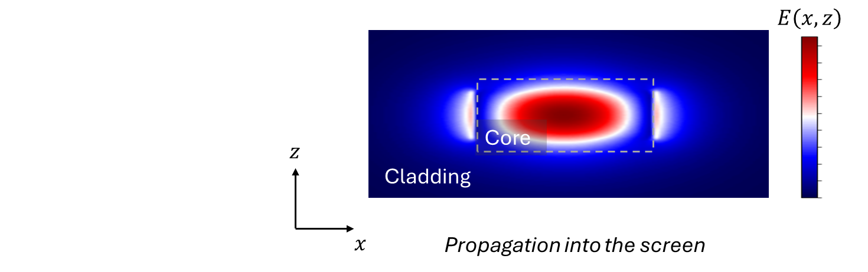



Electric Field in Waveguide
more generally …
$$E\left(x,y,z\right)=E\left(x,z\right)e^{−ik_{e}y}$$
$$z$$
$$y$$
$$x$$

Slide 18
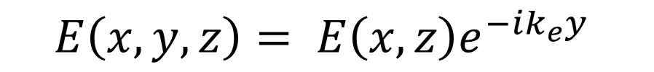
Electric Field in Waveguide
$$E\left(x,y,z\right)= E\left(x,z\right)e^{−ik_{e}y}$$
Plug this into Maxwell’s equations
+ algebra and calculus

Slide 19

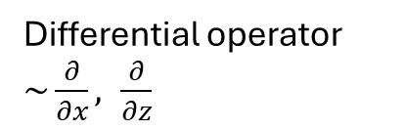
Electric Field in Waveguide
$$E\left(x,y,z\right)= E\left(x,z\right)e^{−ik_{e}y}$$
Plug this into Maxwell’s equations
+ algebra and calculus
$$\hat{A}⋅E\left(x,z\right)=k_{e}^{2}E\left(x,z\right)$$
Differential operator $\sim \frac{∂}{∂x}, \frac{∂}{∂z}$
scalar value

Slide 20

Electric Field in Waveguide
$$E\left(x,y,z\right)=E\left(x,z\right)e^{−ik_{e}y}$$
Plug this into Maxwell’s equations
+ algebra and calculus
$$\hat{A}⋅E\left(x,z\right)=k_{e}^{2}E\left(x,z\right)$$
Differential operator
Eigenvalue problem!

Slide 21
Electric Field in Waveguide
$$E\left(x,y,z\right)=E\left(x,z\right)e^{−ik_{e}y}$$
Plug this into Maxwell’s equations
+ algebra and calculus
$$\hat{A}⋅E\left(x,z\right)=k_{e}^{2}E\left(x,z\right)$$
Differential operator
Effective wavenumber = Eigenvalue
Eigenvalue problem!

Slide 22



Electric Field in Waveguide
$$E\left(x,y,z\right)=E\left(x,z\right)e^{−ik_{e}y}$$
$$\hat{A}⋅E\left(x,z\right)=k_{e}^{2}E\left(x,z\right)$$
Eigenvalue Equation
$$E_{n}\left(x,z\right), { k}_{e,n}$$
Eigenmode solutions
$$n∈integers$$
In general, there are multiple solutions = Waveguide modes

Slide 23
Eigenmode Solvers
Finds waveguide modes for arbitrary waveguide shapes and electromagnetic frequencies
https://www.intechopen.com/chapters/61838

Slide 24
Eigenmode Solvers
Finds waveguide modes for arbitrary waveguide shapes and electromagnetic frequencies
Use only cross-section of the waveguide
z
y
x

Slide 25
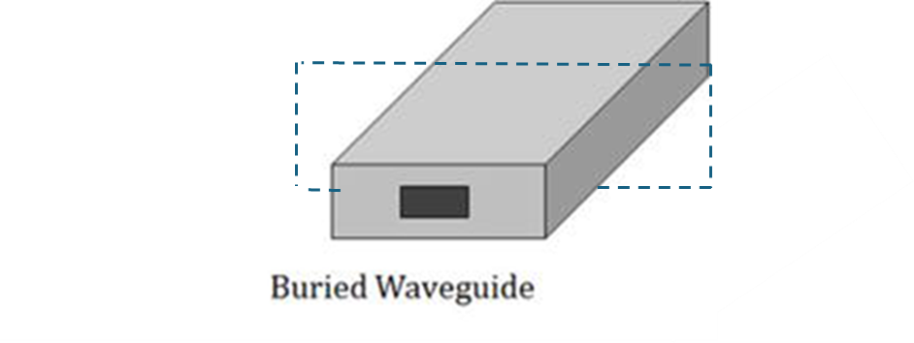
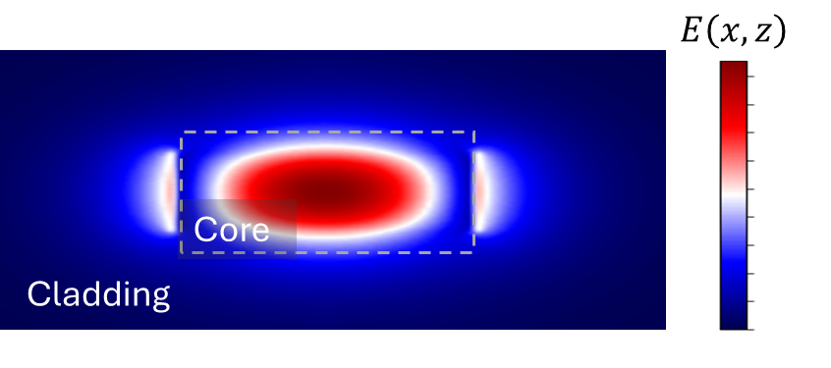
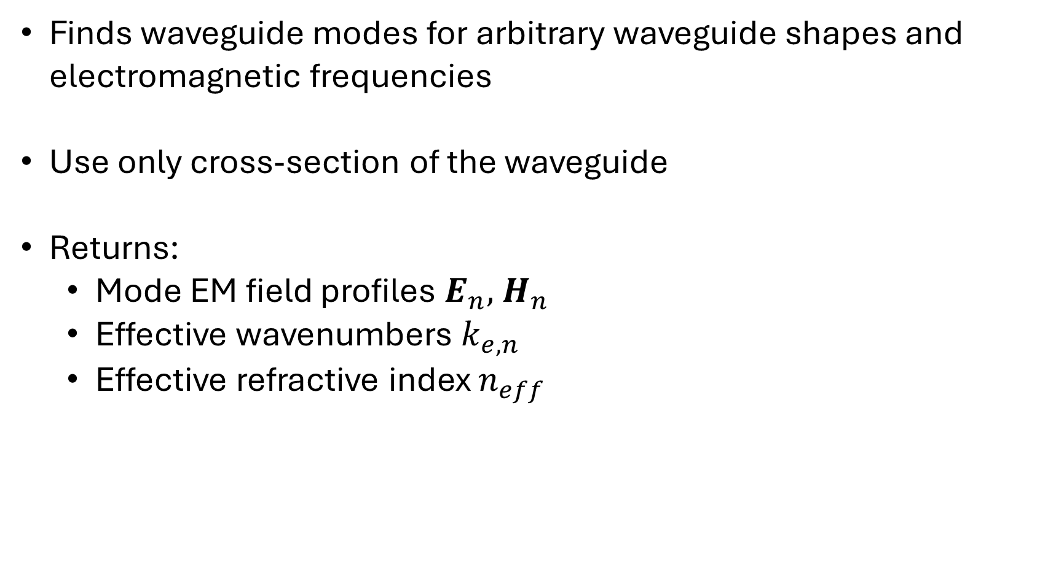

Eigenmode Solvers
Finds waveguide modes for arbitrary waveguide shapes and electromagnetic frequencies
Use only cross-section of the waveguide
Returns:
Mode EM field profiles $E_{n}, { H}_{n}$
Effective wavenumbers $k_{e,n }$
Effective refractive index $n_{eff}$
$$n$$

Slide 26
Eigenmode Solvers
$$E\left(x,y,z\right)=E_{n}\left(x,z\right)e^{−ik_{e,n}y}$$
z
y
x

Slide 27


Eigenmode Solvers
$$E\left(x,y,z\right)=E_{n}\left(x,z\right)e^{−ik_{e,n}y}$$
z
Waveguide cross-section
y
$$ε_{core}$$
z
$$ε_{cladding}$$
x
x

Slide 28


Eigenmode Solvers
$$E\left(x,y,z\right)=E_{n}\left(x,z\right)e^{−ik_{e,n}y}$$
z
Waveguide cross-section
y
$$ε_{core}$$
z
$$ε_{cladding}$$
x
x
Returns mode fields and wavenumber
$$E_{n}\left(x,z\right), k_{e,n}$$

Slide 29
Code break
Use MPB to calculate and visualize the waveguide mode for a buried Silicon-on-insulator waveguide
Si
SiO2

Slide 30
Waveguide modes in FDTD
Eigenmode source
source for waveguide simulations
Eigenmode expansion monitor
monitors for waveguide simulations
z
y
x

Slide 31
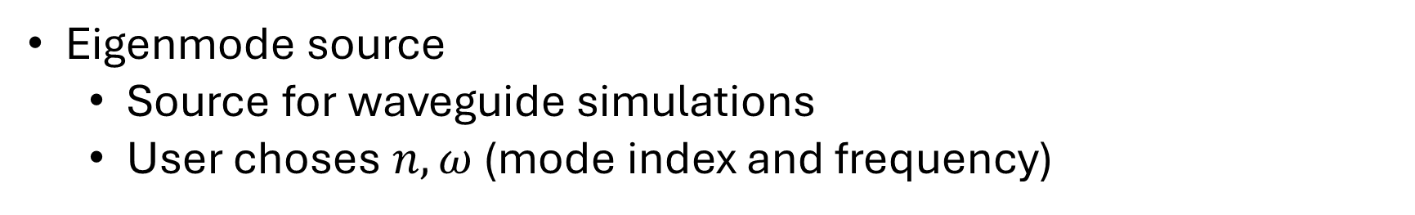
Waveguide modes in FDTD
Eigenmode source
Source for waveguide simulations
User choses $n, ω$ (mode index and frequency)
z
y
x

Slide 32
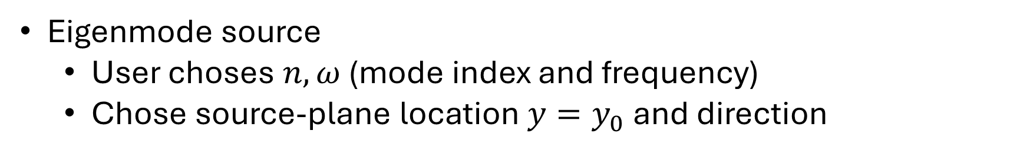

Waveguide modes in FDTD
Eigenmode source
User choses $n, ω$ (mode index and frequency)
Chose source-plane location $y=y_{0}$ and direction
z
y
$$y=y_{0}$$
x

Slide 33
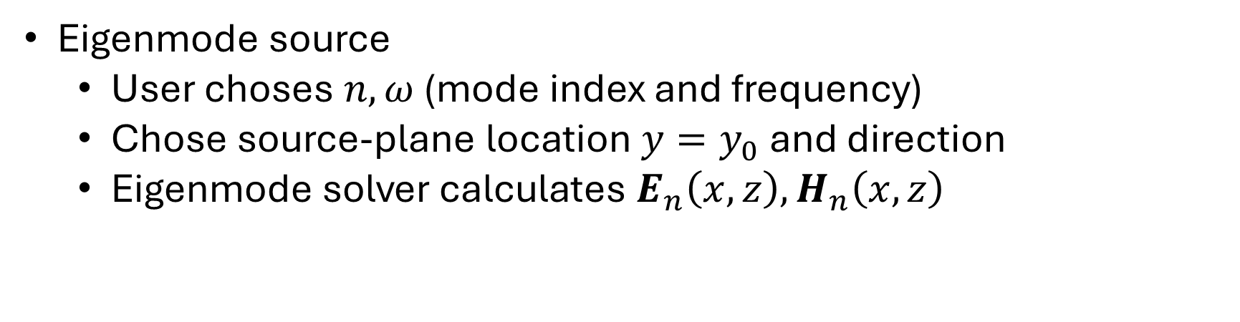

Waveguide modes in FDTD
Eigenmode source
User choses $n, ω$ (mode index and frequency)
Chose source-plane location $y=y_{0}$ and direction
Eigenmode solver calculates $E_{n}\left(x,z\right),H_{n}\left(x,z\right)$
z
y
$$y=y_{0}$$
x

Slide 34
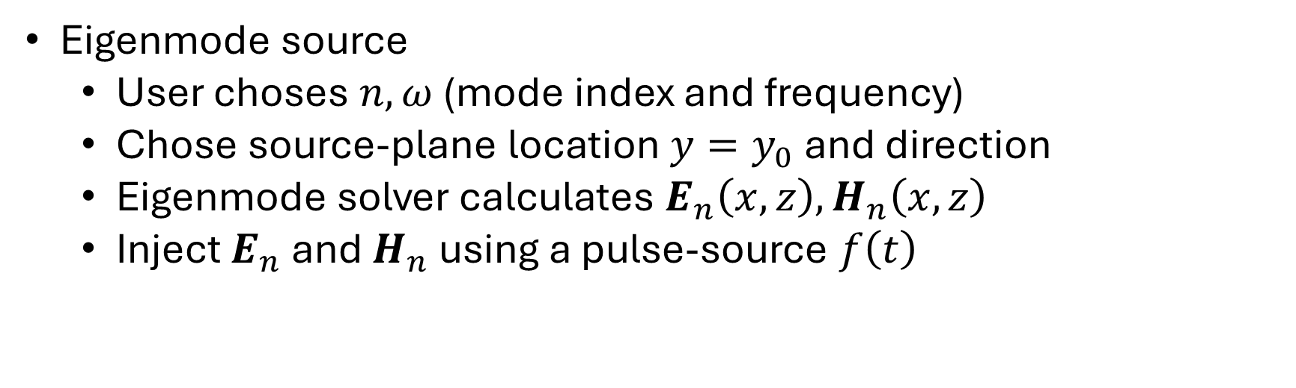


Waveguide modes in FDTD
Eigenmode source
User choses $n, ω$ (mode index and frequency)
Chose source-plane location $y=y_{0}$ and direction
Eigenmode solver calculates $E_{n}\left(x, z\right),H_{n}\left(x,z\right)$
Inject $E_{n}$ and $H_{n}$ using a pulse-source $f\left(t\right)$
$$E_{source}\left(x,y_{0},z,t\right)=E_{n}\left(x,z\right)f\left(t\right)$$
$$H_{source}\left(x,y_{0},z, t\right)=H_{n}\left(x,z\right)f\left(t\right)$$
z
y
$$y=y_{0}$$
x

Slide 35
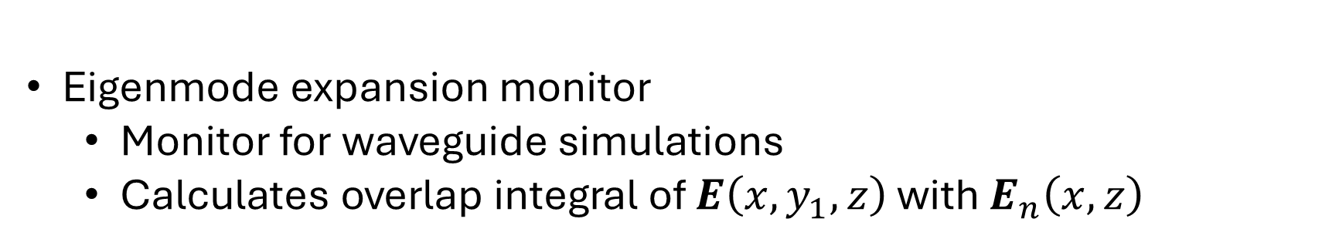

Waveguide modes in FDTD
Eigenmode expansion monitor
Monitor for waveguide simulations
Calculates overlap integral of $E\left(x,y_{1},z\right)$ with $E_{n}\left(x,z\right)$
z
$$y=y_{1}$$
y
x

Slide 36
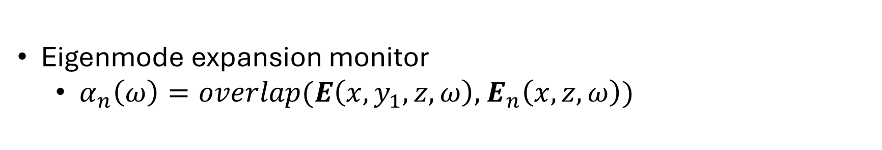
Waveguide modes in FDTD
Eigenmode expansion monitor
$α_{n}\left(ω\right)=overlap(E\left(x,y_{1},z,ω\right),$ $E_{n}\left(x,z,ω\right))$
Mode overlap integral
Mode amplitude
z
$$y=y_{1}$$
y
x

Slide 37
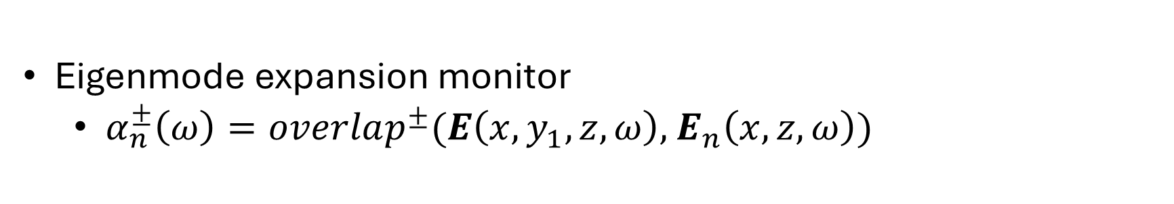
Waveguide modes in FDTD
Eigenmode expansion monitor
$α_{n}^{±}\left(ω\right)=overlap^{±}(E\left(x,y_{1},z,ω\right),$ $E_{n}\left(x,z,ω\right))$
Mode overlap integral
Mode amplitude is directional – can distinguish between backwards (-) and forward (+) travelling fields
z
$$y=y_{1}$$
y
x

Slide 38
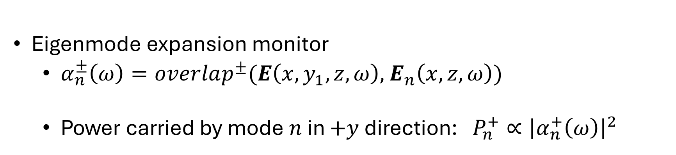
Waveguide modes in FDTD
Eigenmode expansion monitor
$α_{n}^{±}\left(ω\right)=overlap^{±}(E\left(x,y_{1},z,ω\right),$ $E_{n}\left(x,z,ω\right))$
Power carried by mode $n$ in $+y$ direction: $P_{n}^{+}∝{\left|α_{n}^{+}\left(ω\right)\right|}^{2}$
Mode overlap integral
z
$$y=y_{1}$$
y
x

Slide 39
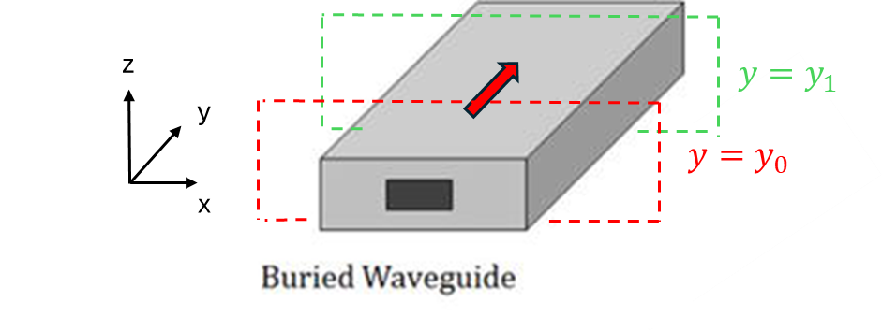
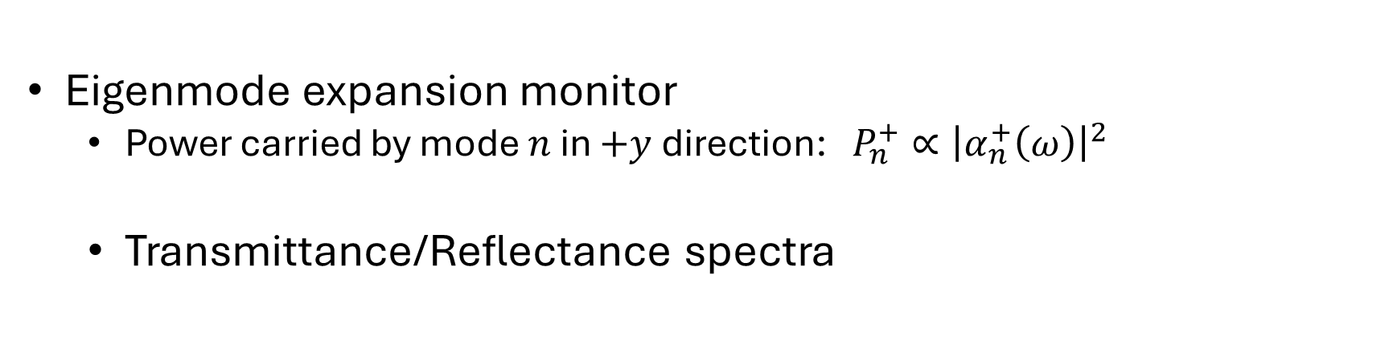


Waveguide modes in FDTD
Eigenmode expansion monitor
Power carried by mode $n$ in $+y$direction: $P_{n}^{+}∝{\left|α_{n}^{+}\left(ω\right)\right|}^{2}$
Transmittance/Reflectance spectra
$$R\left(ω\right)=\frac{{\left|α_{n}^{−}\left(ω,y_{0}\right)\right|}^{2}}{{\left|α_{n}^{+}\left(ω,y_{0}\right)\right|}^{2}}$$
$$T\left(ω\right)=\frac{{\left|α_{n}^{+}\left(ω,y_{1}\right)\right|}^{2}}{{\left|α_{n}^{+}\left(ω,y_{0}\right)\right|}^{2}}$$
Forward mode amplitude in front of source $y_{0}$

Slide 40
Waveguide modes in FDTD
Eigenmode expansion monitor
Power carried by mode $n$ in $+y$direction: $P_{n}^{+}∝{\left|α_{n}^{+}\left(ω\right)\right|}^{2}$
Transmittance/Reflectance spectra
Forward mode amplitude at $y_{1}$
$$R\left(ω\right)=\frac{{\left|α_{n}^{−}\left(ω,y_{0}\right)\right|}^{2}}{{\left|α_{n}^{+}\left(ω,y_{0}\right)\right|}^{2}}$$
$$T\left(ω\right)=\frac{{\left|α_{n}^{+}\left(ω,y_{1}\right)\right|}^{2}}{{\left|α_{n}^{+}\left(ω,y_{0}\right)\right|}^{2}}$$
Forward mode amplitude in front of source $y_{0}$

Slide 41
Waveguide modes in FDTD
Eigenmode expansion monitor
Power carried by mode $n$ in $+y$direction: $P_{n}^{+}∝{\left|α_{n}^{+}\left(ω\right)\right|}^{2}$
Transmittance/Reflectance spectra
Forward mode amplitude at $y_{1}$
Backward mode amplitude a$t y_{0}$
$$R\left(ω\right)=\frac{{\left|α_{n}^{−}\left(ω,y_{0}\right)\right|}^{2}}{{\left|α_{n}^{+}\left(ω,y_{0}\right)\right|}^{2}}$$
$$T\left(ω\right)=\frac{{\left|α_{n}^{+}\left(ω,y_{1}\right)\right|}^{2}}{{\left|α_{n}^{+}\left(ω,y_{0}\right)\right|}^{2}}$$
Forward mode amplitude in front of source $y_{0}$

Slide 42
Code break
Use Meep to simulate light propagating through a buried waveguide
Plot reflectance and transmittance

Slide 43


z
$$y=y_{1}$$
y
$$y=y_{0}$$
x

